Slide 1
3 Replicates of data for A. baumannii infection with CSF treatment
To go in CSF paper
Graph and cox-hazard ratio included
4-22-2020

Slide 2
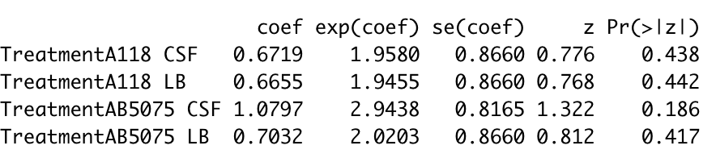
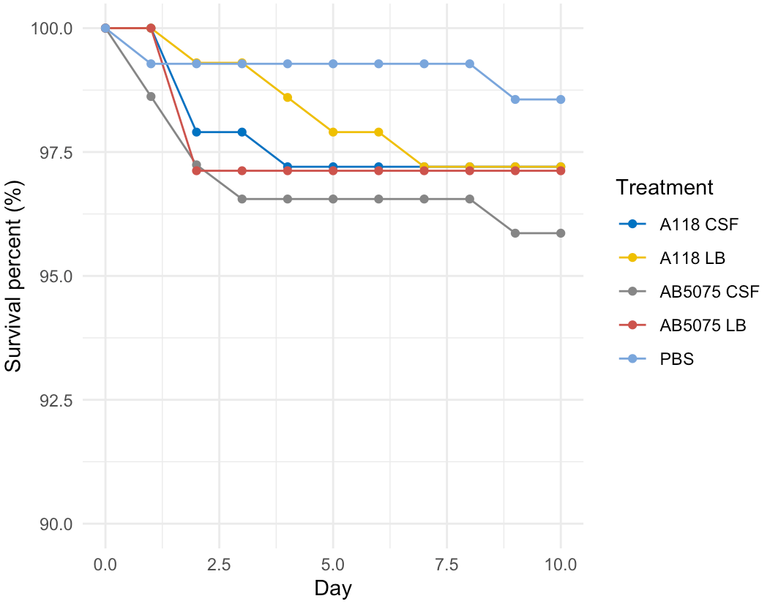
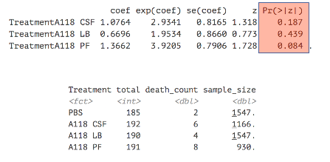
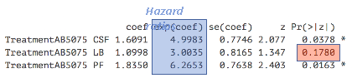
New Cox Model Results 4-22-2020
Bacteria: A118, AB5075 combined
Conditions: PBS (baseline), LB, CSF
Old Cox Model Results
Summary:
A118 CSF: 0.187 → 0.438
A118 LB: 0.439 → 0.442
AB5075 CSF: 0.0378 → 0.186
AB5075 LB: 0.178 → 0.417
Notes:
Redo same model, but remove A42 data
Then redo model and do pairwise comparisons for AB5075 and A118 with LB as the baseline, so comparing the PF mortality to LB within pathogen
Pairwise comparison for A118 between LB and PF
Then redo the CSF data to do pairwise comparisons with LB as baseline, comparing CSF mortality to LB
Then report these results on the “Cox Model Revisions – NEW” PPT

Slide 3
To test the influence of CSF in A. baumanii pathogenesis, a Drosophila melanogaster infection model was used. Inoculation with A118 or AB5075 grown in LB did not affect survival of flies relative to controls (p=0.442, p=0.417). A118 growth in CSF did not affect survival relative to controls (p=0.186). However, for Ab5075 when the bacterial cells were cultured in the presence of CSF, the survival was reduced to 94% of inoculated individuals for (Figure 2C, P-value=0.186). It is noteworthy that the D. melanogaster population used in this study is outbred and has been shown to be more robust than inbred fly lines used in many laboratories (Reference number). Thus, even in highly robust D. melanogaster populations, there is an observable increase in virulence of A. baumannii when exposed to CSF. These results showed that the presence of CSF increases the virulence of A. baumannii. Furthermore, this is, to our best knowledge, the first utilization of D. melanogaster as model of infection of A. baumannii. We are presently performing comparative infection assays using other well-established models to further validate D. melanogaster as a viable and convenient model.

